Slide 1

Group-D : Conditional Statements
Team members:
Prajwal S M
Sachin K S
Hanumantha Reddy
Srinivas m

Slide 2
While writing a shell script, there may be a situation when you need to adopt one path out of the given two paths. So you need to make use of conditional statements that allow your program to make correct decisions and perform the right actions.
Two decision-making statements here −
The if...else statement
The case...esac statement
Conditional Statements

Slide 3
Compare numeric value
Unix provides a number of relational operators in addition to the logical operators mentioned earlier. These can be used to compare numeric values.
-lt less than
-le less than or equal to
-gt greater than
-ge greater than or equal to
-eq equal to
-ne not equal to

Slide 4
if...else statements
If else statements are useful decision-making statements which can be used to select an option from a given set of options.
Unix Shell supports following forms of if…else statement −
if...fi statement
if...else...fi statement
if...elif...else...fi statement

Slide 5
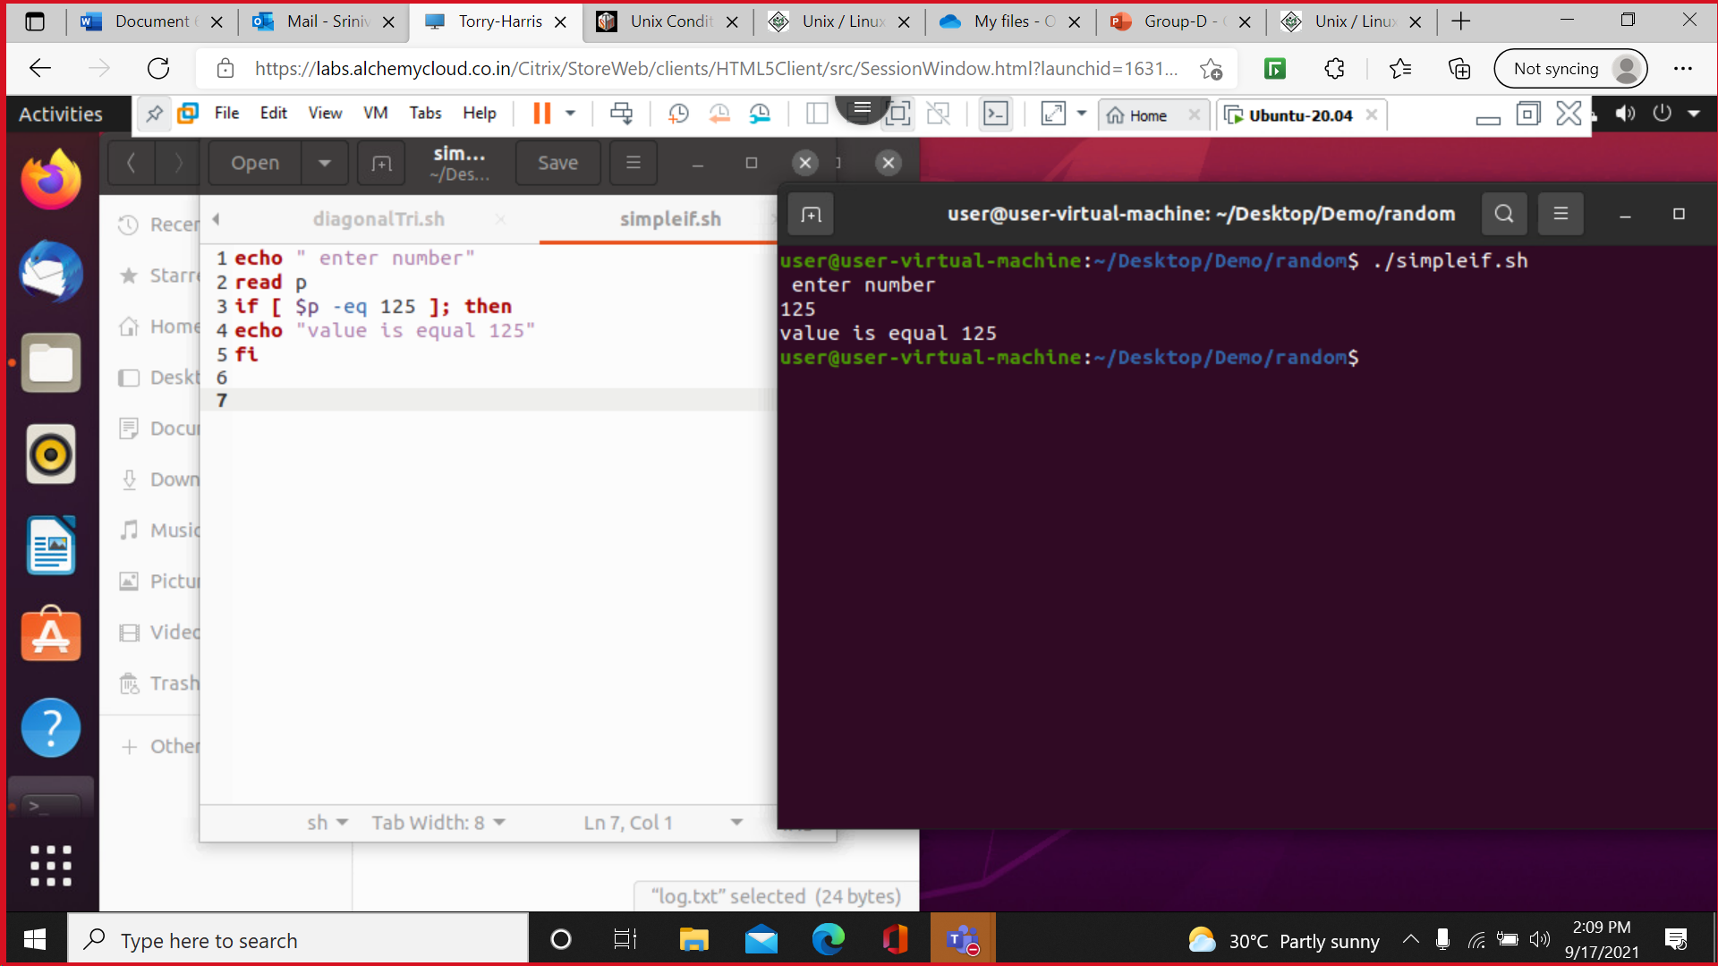
Simple if statements

Slide 6
If..else Statement

Slide 7
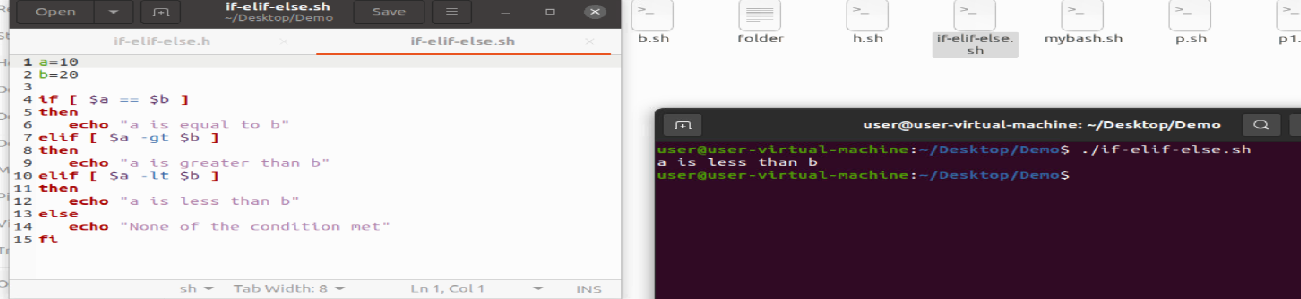
If elif .. else statement

Slide 8
We can use multiple if...elif statements to perform a multiway branch. However, this is not always the best solution, especially when all of the branches depend on the value of a single variable.
Unix Shell supports case...esac statement which handles exactly this situation, and it does so more efficiently than repeated if...elif statements.
There is onlyone-form of case...esac statement which has been described in detail here −
case...esac statement
case...esac Statement

Slide 9
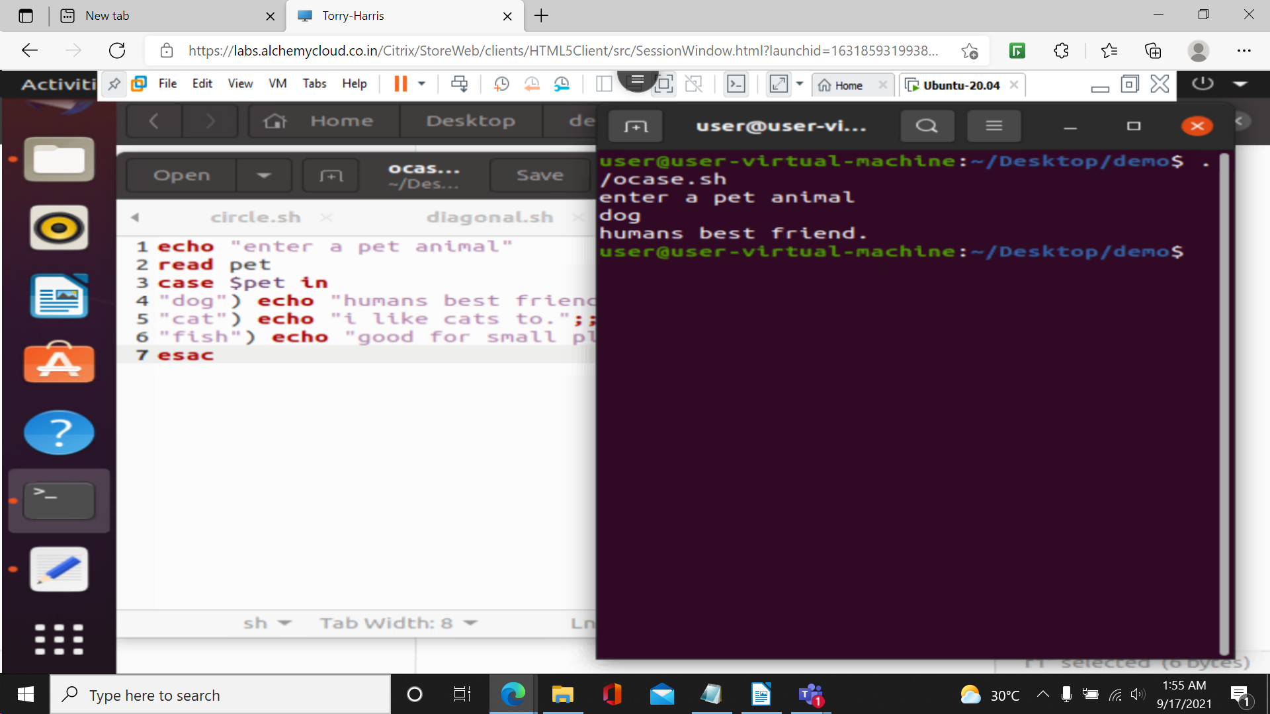
Example

Slide 10
Thankyou

